Slide 1

TDT99: Modern ML for TS analysis
Multivariate time series forecasting via attention-based encoder-decoder framework

Slide 2
Motivation
Time series are ubiquitous
Time series tend to be multivariate

Slide 3
Problem
Time series forecasting is hard
Forecasting gets harder with longer time horizons
Classical methods don’t do well in the modern era

Slide 4
Related Work
Most previous work on time series (ES, ARIMA, ANN, RNN/LSTM)
Bidirectional LSTM
Encoder/Decoder frameworks
Attention mechanisms

Slide 5
Method
New architecture that combines several existing techniques
No specific application – generic architecture

Slide 6
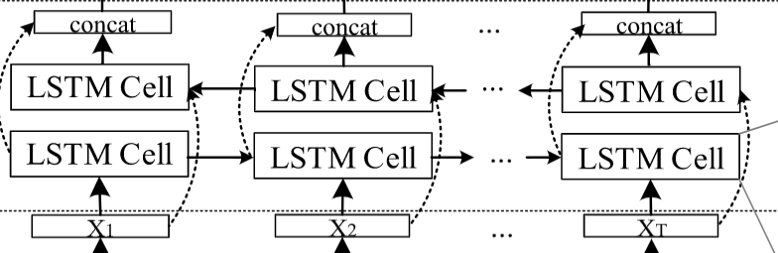
Method: Bidirectional LSTM
RNN/LSTM process inputs sequentially
Bidirectional LSTM process inputs in reverse order as well as in original order

Slide 7
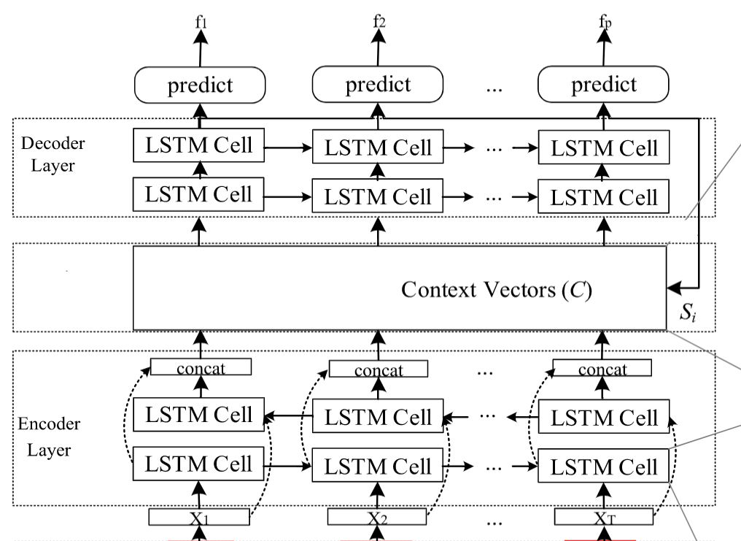
Method: Encoder/Decoder
Encoder converts input sequence into a vector
“Context vector” is used as input for decoder
Encoder is a
bidirectional LSTM

Slide 8
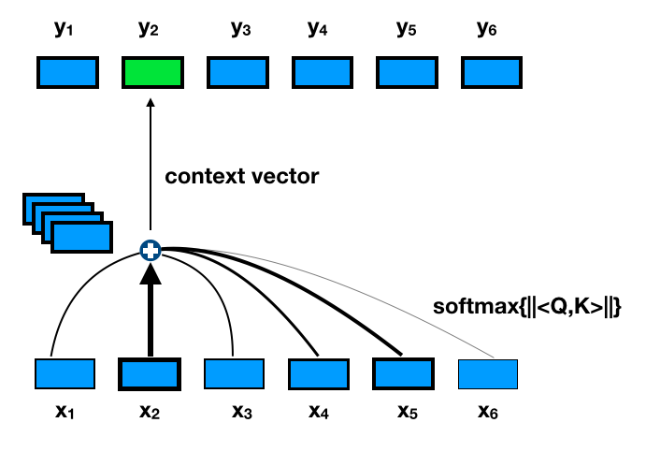
Method: Attention mechanism
Compression of information into context vector is “lossy”
Weights that shift “attention” to important parts of context vector

Slide 9
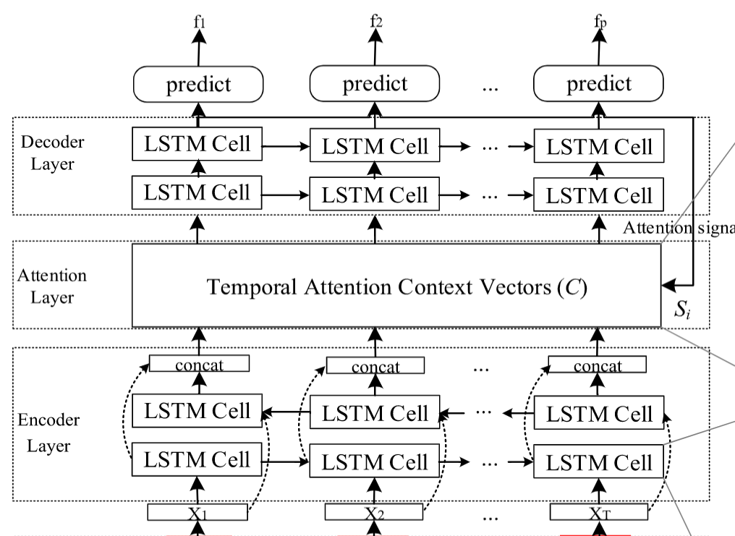
Method: Entire architecture

Slide 10
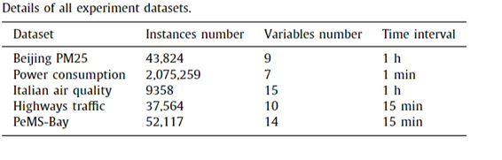
Experimental setup: Data
Five fairly common and well known datasets
All multivariate

Slide 11
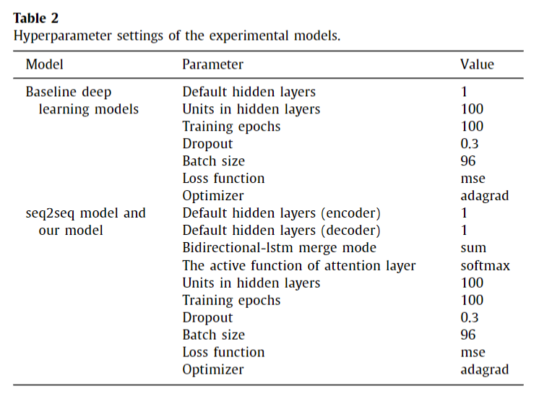
Experimental setup
Implementation in Keras and Sklearn
Standardized hyperparamenters

Slide 12
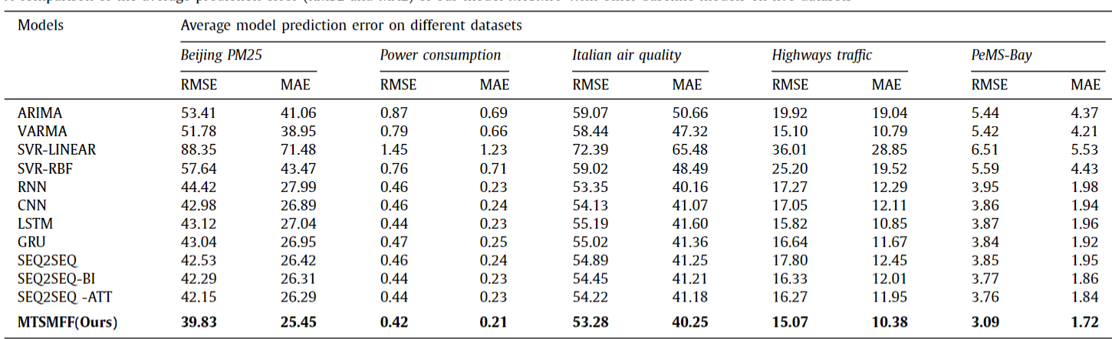
Results
New architecture constitutes a “marginal gain” compared to existing techniques

Slide 13
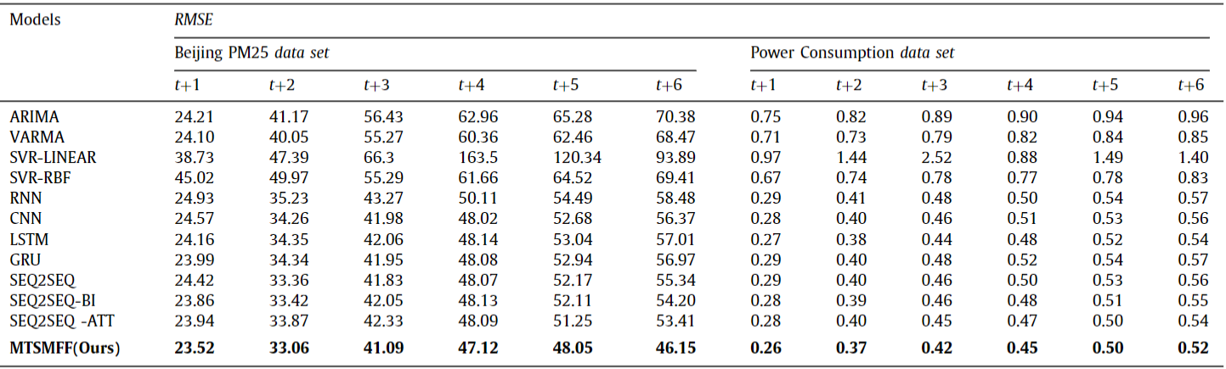
Results 2
Biggest improvements are seen in multi-step prediction

Slide 14
Conclusion
Likely a very good “jack of all trades” architecture
Increased computational cost compared to baseline – common problem in ML
Paper feels very ‘A Posterior’
Bidirectional LSTM’s probably highly relevant in my own project/master’s thesis

